Slide 1


AI Integration in Mount Sinai Health System: A Cloud-Native Approach
Welcome to my presentation on the implementation of AI capabilities for Mount Sinai Health System's website. I will walk through the comprehensive solution that enables patients to submit medical queries and receive responses powered by a fine-tuned LLaMA model.
This cloud-native application leverages Kubernetes, Azure services, and modern DevOps practices to create a scalable, secure, and maintainable system. We will explore the architecture, implementation details, and deployment processes that make this solution possible.
by Sayan Banerjee

Slide 2





Project Requirements & Analysis
Management Directive
Enhance Mount Sinai's website with AI capabilities for patient queries about medications, diseases, treatments, and health information
Technical Requirements
Scalable microservices architecture with minimal response delays, seamless integration with existing website
AI Component
Lightweight LLaMA model fine-tuned for medical knowledge and healthcare-specific responses
Security Considerations
Protect patient data and ensure compliance with healthcare regulations throughout the system

Slide 3










Solution Architecture
Frontend
HTML, CSS, JavaScript
Backend
Python FastAPI
AI Engine
LLaMA 3.2–1B fine-tuned model
Infrastructure
Azure Kubernetes Service, Terraform
Security
Microsoft Defender, Entra ID, Sentinel
Our solution follows a modern cloud-native architecture pattern with clearly separated concerns. Each layer is designed to be independently scalable and maintainable, following microservices principles to ensure the system can evolve over time.

Slide 4








Containerization Strategy
Application Code
Docker Images
Python FastAPI backend and LLaMA model implementation
Containerized applications with optimized dependencies
Kubernetes Deployment
Container Registry
AKS orchestrates containers for high availability
Azure Container Registry for image storage
My containerization approach ensures consistency across development, testing, and production environments. By packaging the application and its dependencies into containers, we eliminate "works on my machine" problems and enable efficient scaling based on demand patterns.

Slide 5
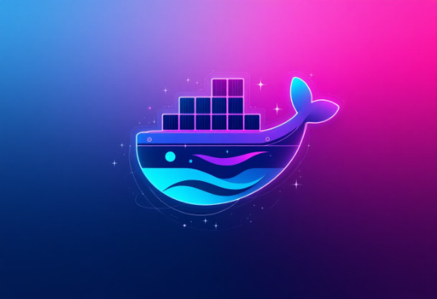


Containerization Implementation:
Docker Registry
Git Repo
Azure Repo
The Docker Registry stores and manages Docker images, providing a centralized location for accessing container images.
The Git repository hosts the source code, configurations, and deployment scripts for the application, enabling version control and collaboration.
Azure Repos provides cloud-hosted private Git repositories for secure and scalable source control management within the Azure ecosystem.
Link: https://hub.docker.com/search?q=sayan896
Link: https://github.com/Sayan8967/myaiwebapp/tree/V3.Kube_Prod

Slide 6
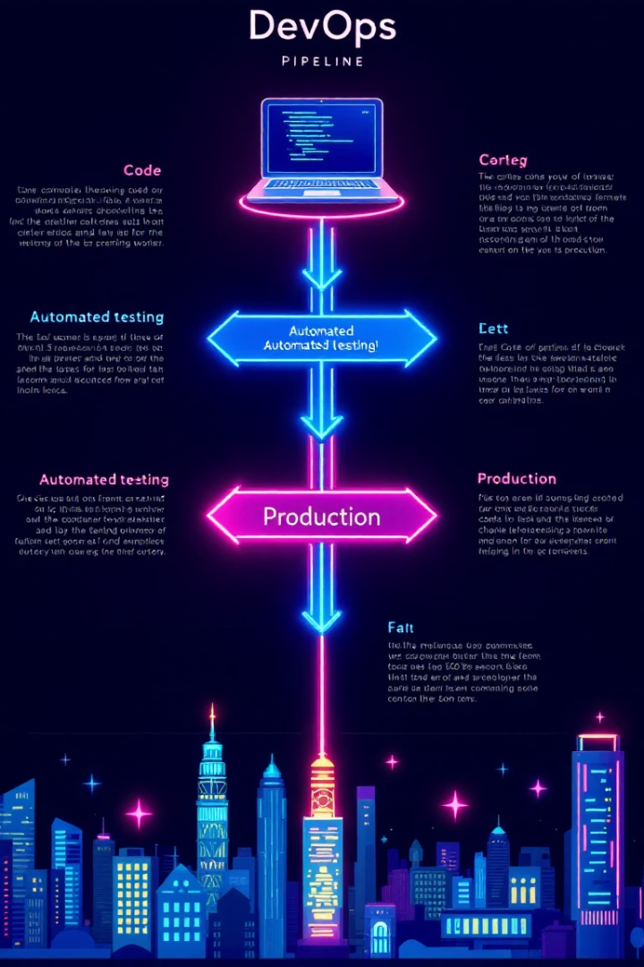




Infrastructure as Code & DevOps
Version Control
Git repositories in Azure Repos
Infrastructure Code
Terraform modules for Azure resources
CI/CD Pipeline
Azure DevOps automated workflows
Deployment
Automated AKS provisioning
Our Infrastructure as Code approach with Terraform enables reproducible deployments and version-controlled infrastructure changes. The entire environment can be recreated from scratch using declarative configuration files, eliminating manual configuration drift.
Azure DevOps pipelines automate the build, test, and deployment processes, ensuring consistent delivery of new features and bug fixes while maintaining high quality standards.

Slide 7






Terraform Configuration – Key Highlights
Resource Group Creation
Azure Kubernetes Service (AKS) Provisioning
Created Azure resource group named webapp-resource in Canada Central.
Deployed an AKS cluster with:
1 node (Standard\_D4ds\_v5 - 4 vCPUs, 16 GB RAM).
System-assigned managed identity.
DNS prefix for AKS configured.
Kubernetes Provider Configuration
NGINX Ingress Setup
Kubernetes provider dynamically configured using AKS credentials. Kubeconfig written to local file for CLI access.
Applied NGINX Ingress Controller via kubectl. Scripted wait logic to ensure Ingress Controller is ready before proceeding.
Ollama Model Deployment
Backend (FastAPI) Deployment
Deployed a containerized LLaMA 3.2–1B model:
Backend service handles AI queries:
Exposed via ClusterIP service.
Uses Ollama API endpoint.
Resource requests/limits optimized (5–6Gi RAM, 2 CPU).
Exposed on port 8000 via ClusterIP service.
Integrated health check with readiness probe.
Frontend Deployment
Ingress Controller Configuration
HTML/CSS/JS-based frontend:
Defined NGINX-based Ingress routes:
Dockerized and deployed.
/ → Frontend Service.
Exposed on port 80.
/api → Backend Service.
Link: https://github.com/Sayan8967/myaiwebapp/blob/V3.Kube\_Prod/terraform-deployment.tf

Slide 8
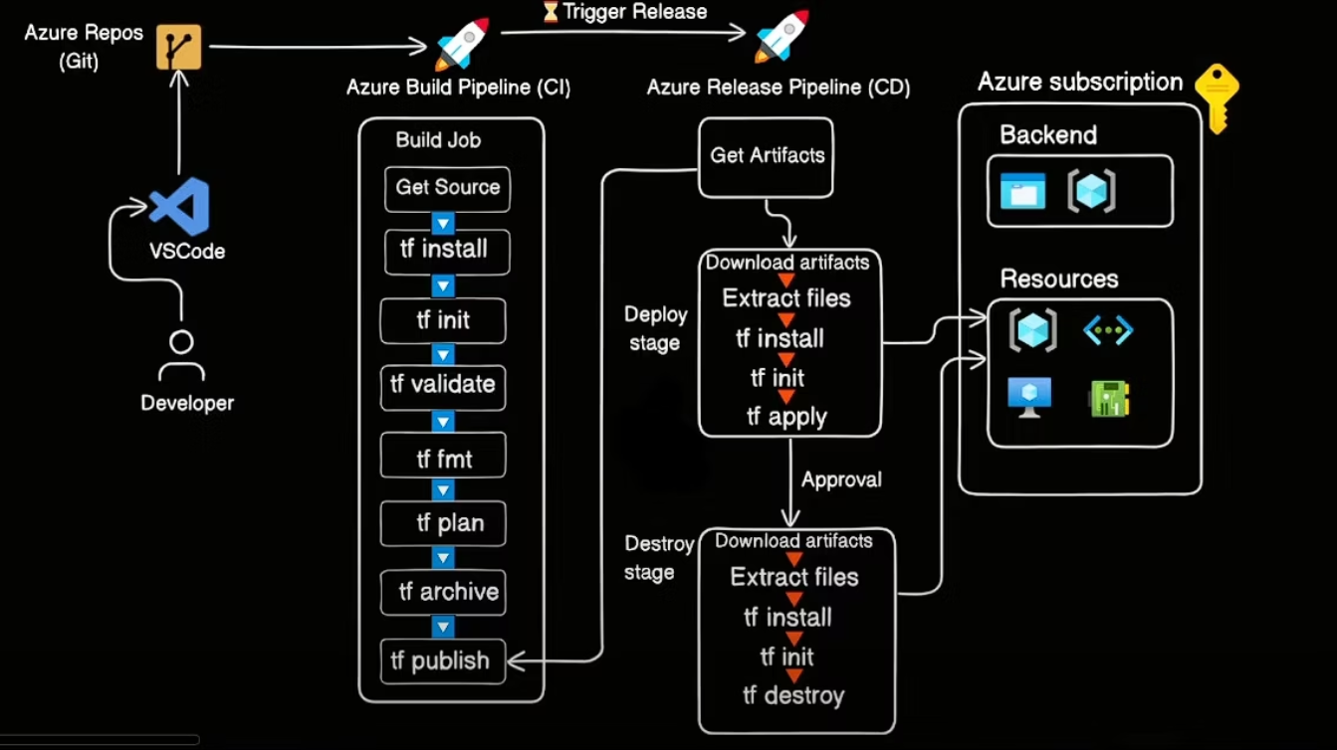
CI/CD Deployment Chart:

Slide 9
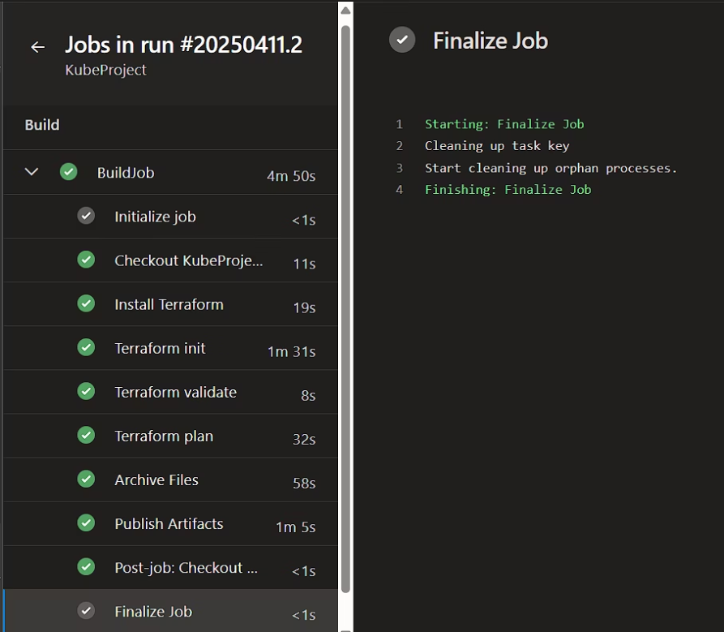
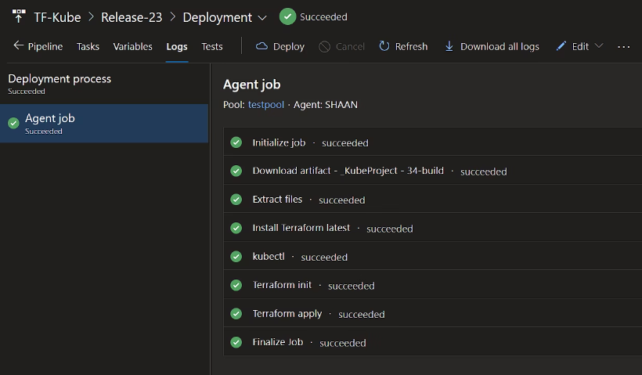
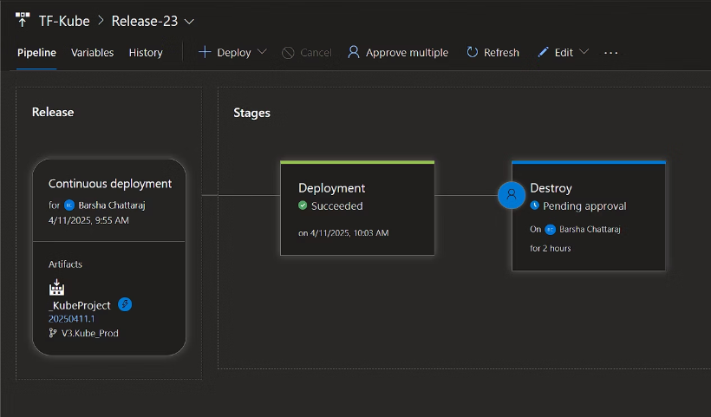
Azure DevOps with CI/CD integration:

Slide 10
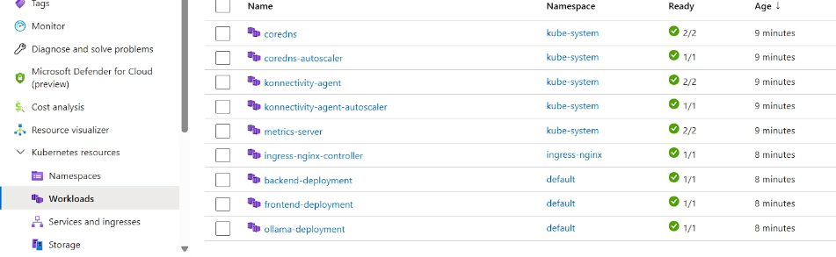
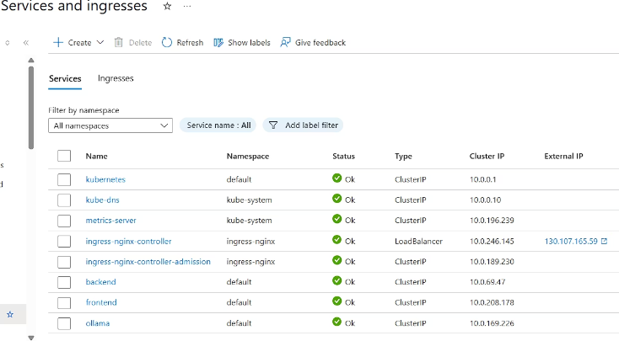
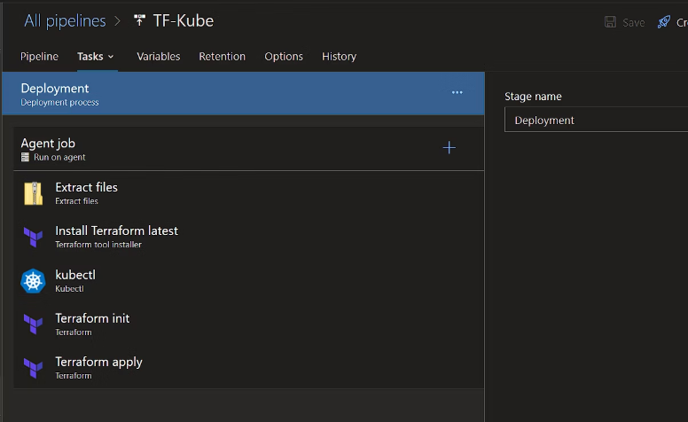
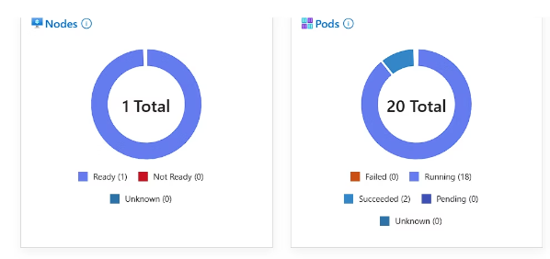
Cont.

Slide 11

AI Model Implementation
Integration & Optimization
Fine-Tuning Process
Model deployment within Kubernetes with CPU/GPU resource allocation, response caching, and query preprocessing to enhance performance.
Base Model Selection
Specialized training using curated medical datasets from Mount Sinai's knowledge base, focusing on common patient queries and evidence-based responses.
Starting with LLaMA 3.2-1B for its balance of performance and resource efficiency. This lightweight model requires less computational power while maintaining reasonable accuracy.
The LLaMA model inference is integrated as a microservice, allowing independent scaling based on query volume. I have implemented rate limiting and monitoring to ensure the model remains responsive even during peak usage periods.
Link: https://ollama.com/library/llama3.2:1b

Slide 12
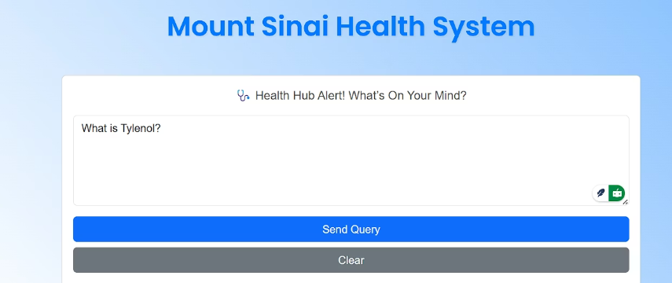
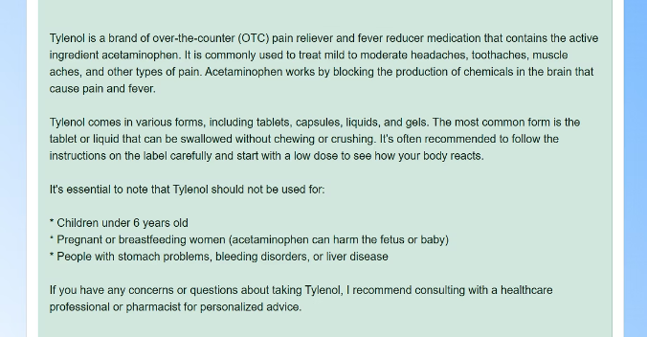
Final Result:

Slide 13

Security & Compliance Framework
Microsoft Defender for Cloud
Real-time threat protection
Vulnerability scanning
Compliance monitoring
Microsoft Entra ID
Role-based access control
Multi-factor authentication
Service principal management
Microsoft Sentinel
Security event monitoring
Threat intelligence
Security analytics
Given the sensitive nature of healthcare data, our security framework implements defense-in-depth strategies across all application layers. We employ automated vulnerability scanning and compliance checks to ensure ongoing protection.
Healthcare Compliance
HIPAA alignment
PHI protection measures
Access auditing

Slide 14




Implementation Roadmap & Key Takeaways
Phase 1: Infrastructure Setup
Provisioning Azure resources via Terraform, establishing CI/CD pipelines
Phase 2: AI Model Development
Fine-tuning LLaMA model with medical datasets, containerization
Phase 3: Frontend & Backend Integration
Developing query interface, API endpoints, and response handling
4
Phase 4: Security Hardening & Testing
Implementing security controls, penetration testing, compliance verification
Phase 5: Deployment & Monitoring
Production rollout, performance monitoring, user feedback collection
This cloud-native approach provides Mount Sinai with a scalable, secure platform for AI-powered patient interactions. The microservices architecture ensures maintenance and updates can occur without disrupting the entire system.
By leveraging Kubernetes, Azure services, and modern DevOps practices, I have created a solution that can grow and evolve alongside Mount Sinai's needs and technological advancements in healthcare AI.

